Slide 1
Carbon inputs to terrestrial ecosystems

Slide 2
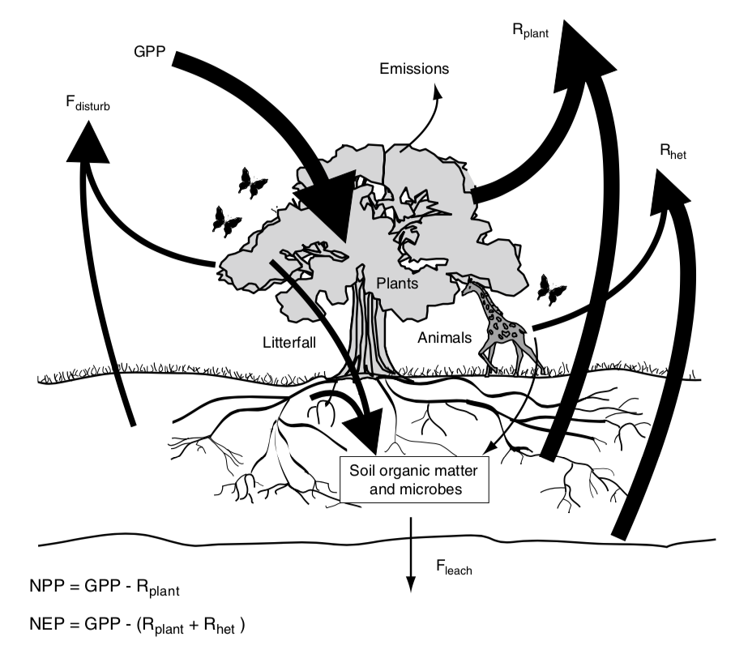
Terrestrial Ecosystem Carbon Cycle

Slide 3
Terrestrial Ecosystem Carbon Cycle
Arrows represent fluxes
How do these compare to anthropogenic carbon fluxes?

Slide 4
Terrestrial Ecosystem Carbon Cycle

Slide 5
NPP = GPP - R_{plant}

Slide 6
NPP = GPP - R_{plant}
Net Primary Productivity (C into plants – C out of plants; per ground area)

Slide 7
NPP = GPP - R_{plant}
Gross Primary Productivity (total flux of C into plants; per ground area)

Slide 8
NPP = GPP - R_{plant}
Plant Respiration (total flux of C out of plants ; per ground area)

Slide 9
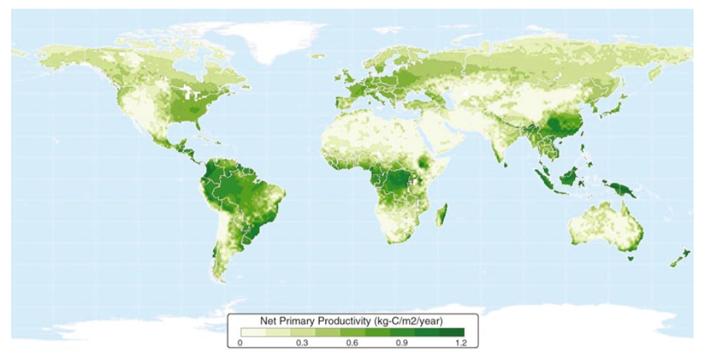
What patterns do you see?

Slide 10
NPP = GPP - R_{plant}
Gross Primary Productivity (total flux of C into plants; per ground area)

Slide 11
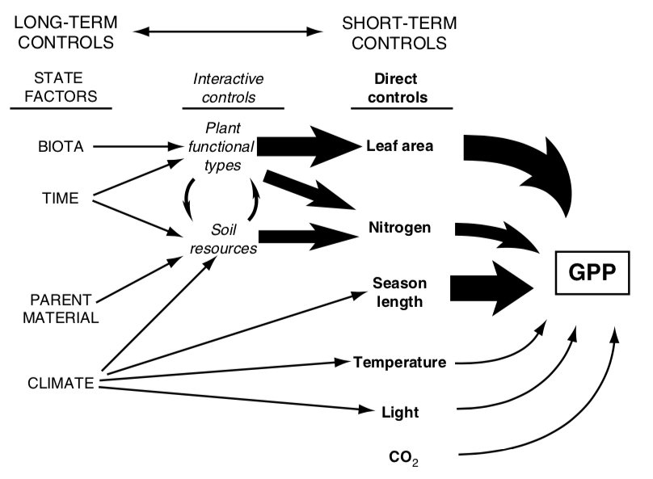

Slide 12
GPP = photosynthesis * LAI

Slide 13
GPP = photosynthesis * LAI
Carbon in to leaves (per leaf area)

Slide 14
GPP = photosynthesis * LAI
Leaf area index (leaf area per ground area)

Slide 15
GPP = photosynthesis * LAI
Carbon in to leaves (per leaf area)

Slide 16
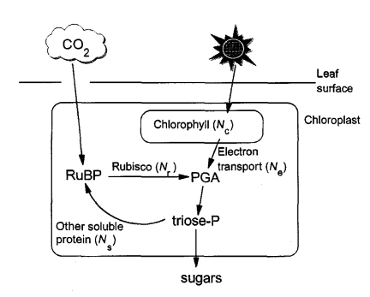
Simple recap of photosynthesis
Medlyn 1996

Slide 17
Simple recap of photosynthesis
Medlyn 1996

Slide 18
Photorespiration
Rubisco : RibUlose – 1,5 – BISphosphate Carboxylase and Oxygenase
Catalyzes CO₂ and O₂
Catalyzing O₂ leads to “wasteful” respiration (loss of CO₂)
Increases as O₂ increases
Increases with temperature

Slide 19
3 types of photosynthesis systems
C₃: what we already covered
Most plants
C₄: Separate carbon acquisition and sugar creation in space
Typically grasses
CAM: Separate carbon acquisition and sugar creation in time
E.g., Cacti

Slide 20
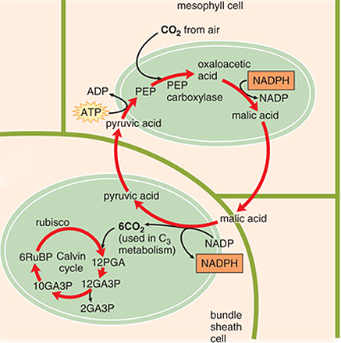
C4 photosynthesis
PEP carboxylase captures CO₂ and creates a 4 carbon sugar in mesophyll
Moves sugar to bundle sheath, where CO2 is removed
Bundle sheath cells surround veins
Calvin cycle progresses as normal
“Costs” two extra ATPs

Slide 21
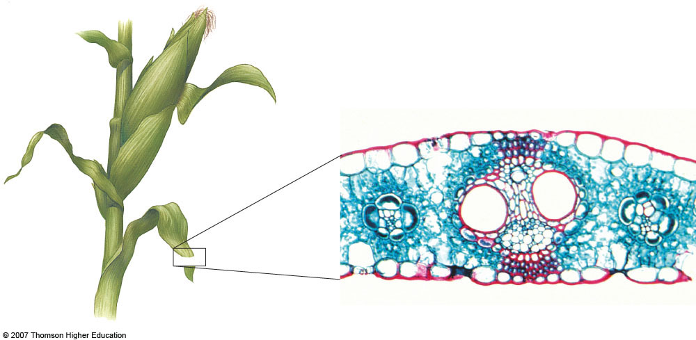
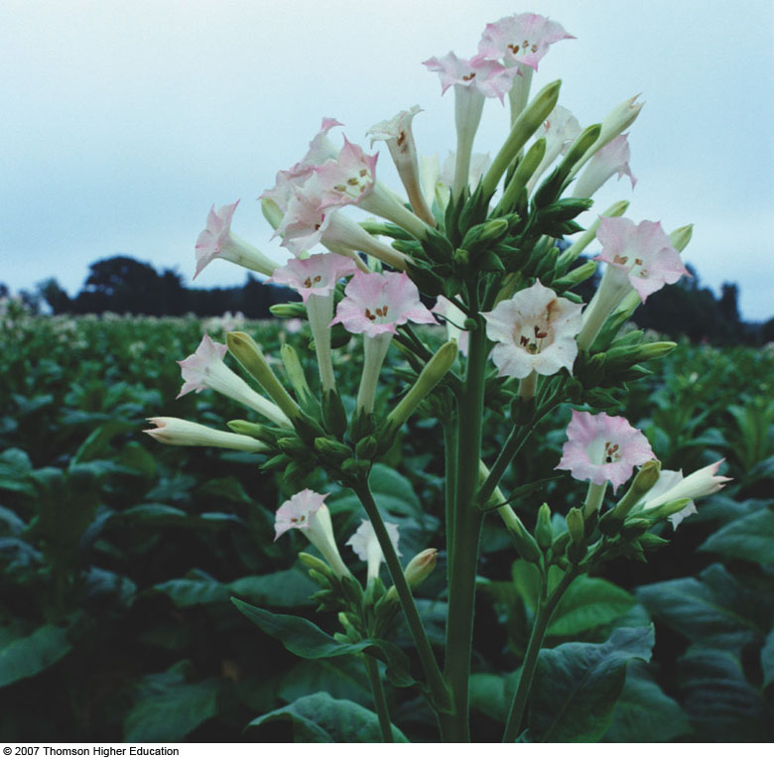
C4 photosynthesis – why the bundle sheath?
Bundle sheath cells
Midvein
Parallel vein
Mesophyll
Upper epidermis
Lower epidermis
Phloem
Xylem

Slide 22
C4 photosynthesis - benefits
PEP carboxylase is not an oxygenase
Good at capturing CO2
Good in low CO2 environments
Good in hot, dry environments
Can close stomata

Slide 23
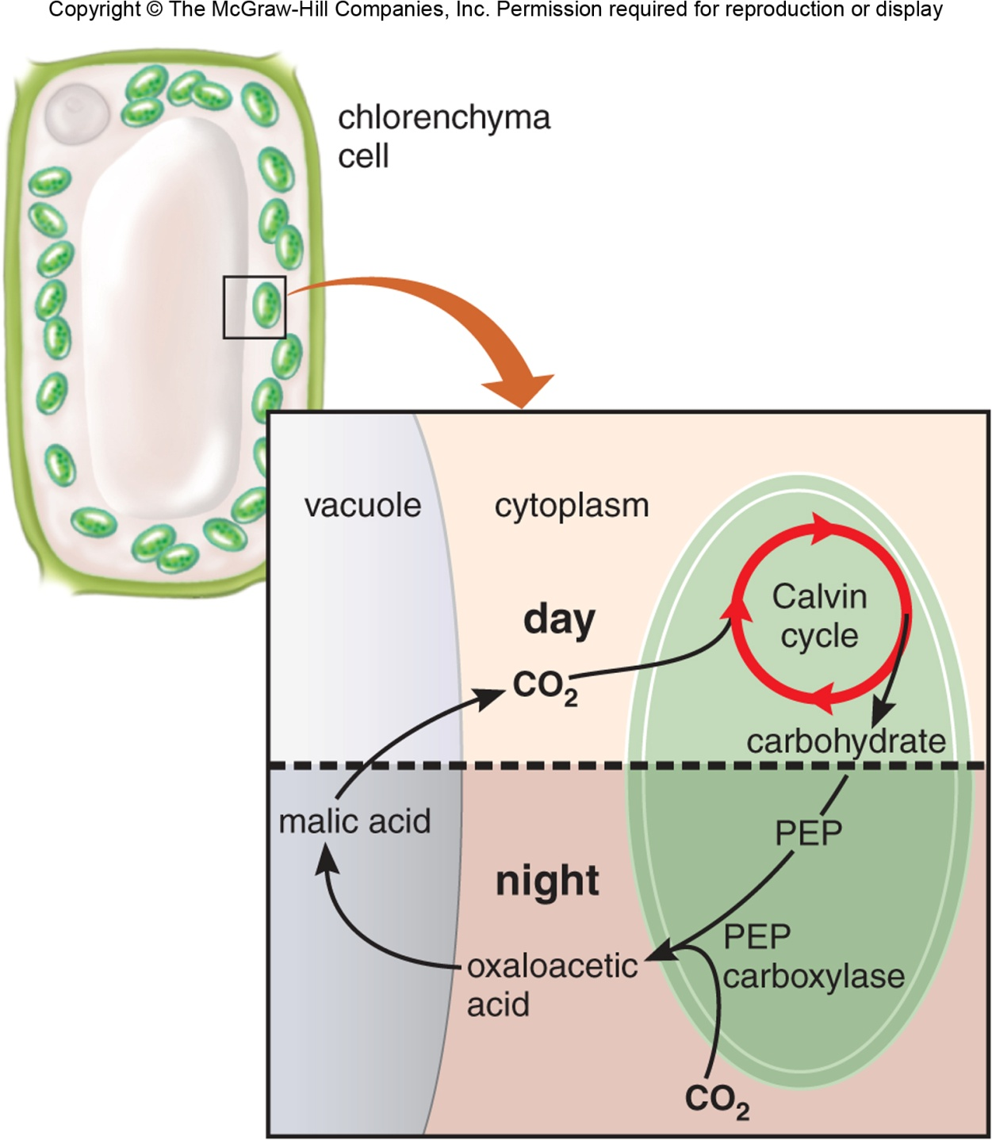
CAM photosynthesis
Opens stomata during the night
PEP carboxylase captures CO₂ and creates a 4 carbon sugar
Closes stomata during the day
Calvin cycle

Slide 24
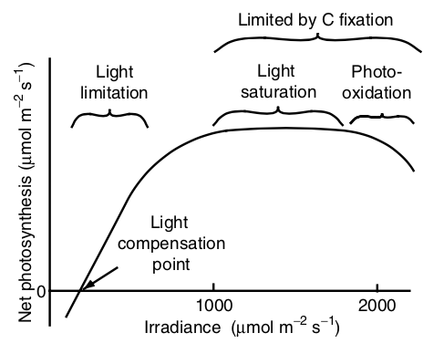
Environmental responses - light

Slide 25
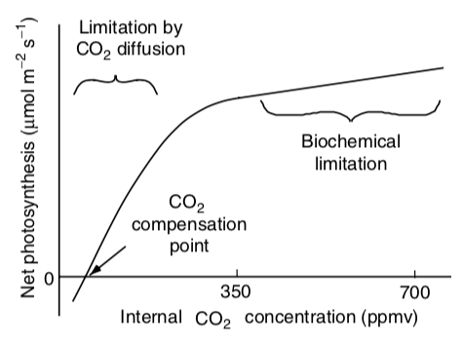
Environmental responses – CO₂

Slide 26
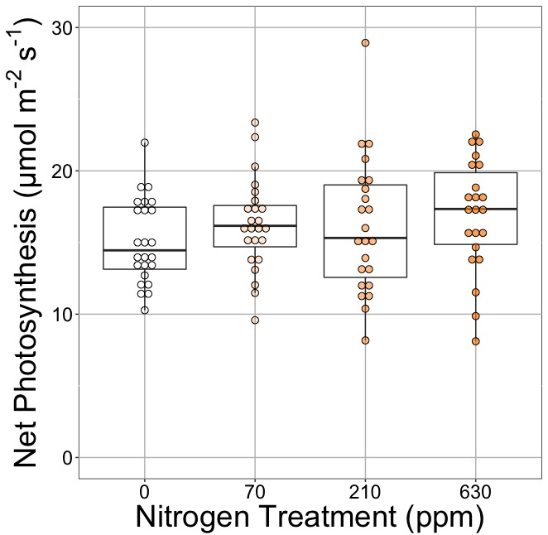
Photosynthesis is less responsive to soil resources (water and nutrients). Why?
Waring et al. (2023)

Slide 27
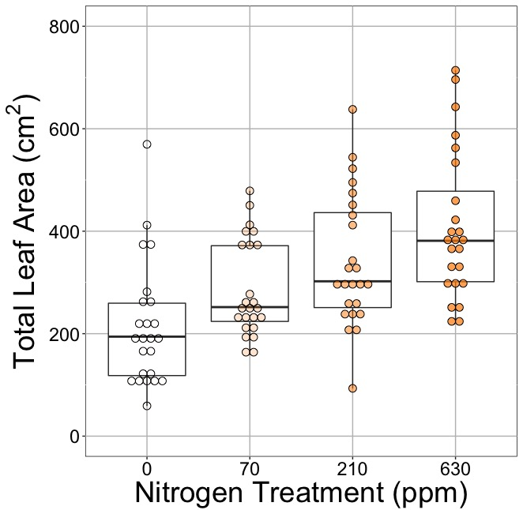
Photosynthesis is less responsive to soil resources (water and nutrients). Why?
Waring et al. (2023)

Slide 28
GPP = photosynthesis * LAI
Leaf area index (leaf area per ground area)

Slide 29
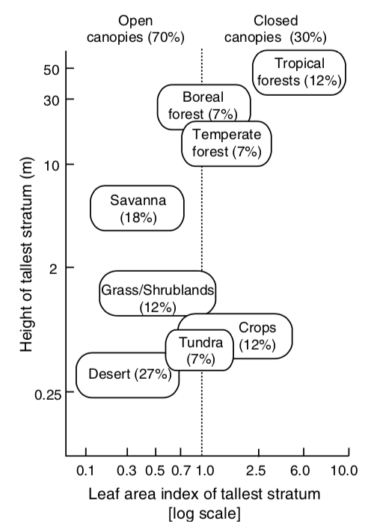
What’s driving the x-axis distribution?

Slide 30
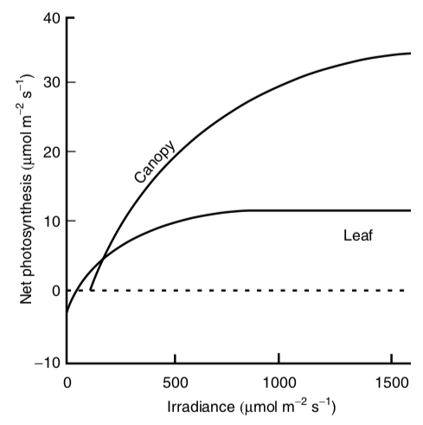
Canopies tend to have higher light use efficiency than leaves

Slide 31
NPP = GPP - R_{plant}
Plant Respiration (total flux of C out of plants ; per ground area)

Slide 32
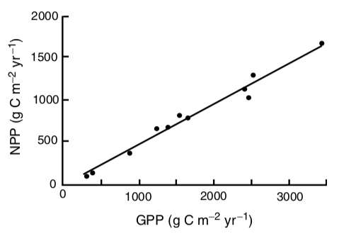
NPP = GPP – 0.5*GPP

Slide 33
What drives NPP?
Over short time scales (seconds to days)
Photosynthesis
Light, temperature, atmospheric conditions
Over long time scales (weeks to months)
LAI
Growth demand
Soil resources

Slide 34
